Slide 1
Process and threads
CS 537 – Introduction to Operating Systems

Slide 2
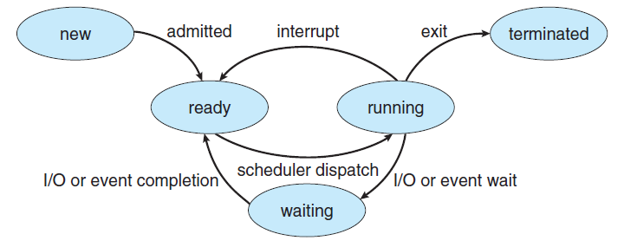
Process life cycle

Slide 3
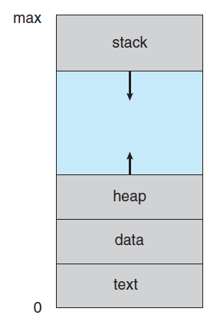
Memory

Slide 4
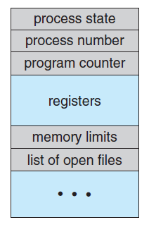
Process Control Block
To maintain the management information about a process the operating system uses the process control block (PCB).

Slide 5
Process vs Threads
Process contains threads
Unit of execution
Allocated memory vs No memory
Memory reclaimed by OS / Process

Slide 6
What are pthreads?
Posix 1003.1c defines a thread interface
  pthreads
  defines how threads should be created, managed, and destroyed
Unix provides a pthreads library
  API to create and manage threads
  you don’t need to worry about the implementation details
    this is a good thing

Slide 7
Creating Threads
Prototype:
  int pthread_create(pthread_t *tid, const pthread_attr_t *tattr, void*(*start_routine)(void *), void *arg);
    tid: an unsigned long integer that indicates a threads id
    tattr: attributes of the thread – usually NULL
    start_routine: the name of the function the thread starts executing
    arg: the argument to be passed to the start routine – only one
  after this function gets executed, a new thread has been created and is executing the function indicated by start_routine

Slide 8
Waiting for a Thread
Prototype:
  int pthread_join(thread_t tid, void **status);
    tid: identification of the thread to wait for
    status: the exit status of the terminating thread – can be NULL
  the thread that calls this function blocks its own execution until the thread indicated by tid terminates its execution
    finishes the function it started with or
    issues a pthread_exit() command – more on this in a minute

Slide 9
Example
    #include <stdio.h>
    #include <pthread.h>
    void printMsg(char* msg) {
    printf(“%s\n”, msg);
    }
    int main(int argc, char** argv) {
    pthread_t thrdID;
    printf(“creating a new thread\n”);
    pthread_create(&thrdID, NULL, (void*)printMsg, argv[1]);
    printf(“created thread %d\n”. thrdID);
    pthread_join(thrdID, NULL);
    return 0;
    }

Slide 10
Example
thrd 0
thrd 1
create_thread()
start of printMsg()
end of printMsg()
end of program
Note: thrd 0 is the function that contains main() – only one main() per program

Slide 11
Exiting a Thread
pthreads exist in user space and are seen by the kernel as a single process
  if one issues and exit() system call, all the threads are terminated by the OS
  if the main() function exits, all of the other threads are terminated
To have a thread exit, use pthread_exit()
Prototype:
  void pthread_exit(void *status);
    status: the exit status of the thread – passed to the status variable in the pthread_join() function of a thread waiting for this one

Slide 12
Example Revisited
    #include <stdio.h>
    #include <pthread.h>
    void printMsg(char* msg) {
    int status = 0;
    printf(“%s\n”, msg);
    pthread_exit(&status);
    }
    int main(int argc, char** argv) {
    pthread_t thrdID;
    int* status = (int*)malloc(sizeof(int));
    printf(“creating a new thread\n”);
    pthread_create(&thrdID, NULL, (void*)printMsg, argv[1]);
    printf(“created thread %d\n”. thrdID);
    pthread_join(thrdID, &status);
    printf(“Thread %d exited with status %d\n”, thrdID, *status);
    return 0;
    }

Slide 13
Synchronizing Threads
Three basic synchronization primitives
    mutex locks
    condition variables
    semaphores
Mutexes and condition variables will handle most of the cases you need in this class
  but feel free to use semaphores if you like

Slide 14
Mutex Locks
A Mutex lock is created like a normal variable
  pthread_mutex_p mutex;
Mutexes must be initialized before being used
  a mutex can only be initialized once
  prototype:
    int pthread_mutex_init(pthread_mutex_t *mp, const pthread_mutexattr_t *mattr);
      mp: a pointer to the mutex lock to be initialized
      mattr: attributes of the mutex – usually NULL

Slide 15
Locking a Mutex
To insure mutual exclusion to a critical section, a thread should lock a mutex
  when locking function is called, it does not return until the current thread owns the lock
  if the mutex is already locked, calling thread blocks
  if multiple threads try to gain lock at the same time, the return order is based on priority of the threads
    higher priorities return first
    no guarantees about ordering between same priority threads
  prototype:
    int pthread_mutex_lock(pthread_mutex_t *mp);
      mp: mutex to lock

Slide 16
Unlocking a Mutex
When a thread is finished within the critical section, it needs to release the mutex
  calling the unlock function releases the lock
  then, any threads waiting for the lock compete to get it
  very important to remember to release mutex
  prototype:
    int pthread_mutex_unlock(pthread_mutex_t *mp);
      mp: mutex to unlock

Slide 17
Example
#include <stdio.h>
#include <pthread.h>
#define MAX_SIZE 5
pthread_mutex_t bufLock;
int count;
void producer(char* buf) {
for(;;) {
while(count == MAX_SIZE);
pthread_mutex_lock(bufLock);
buf[count] = getChar();
count++;
pthread_mutex_unlock(bufLock);
}
}
void consumer(char* buf) {
for(;;) {
while(count == 0);
pthread_mutex_lock(bufLock);
useChar(buf[count-1]);
count--;
pthread_mutex_unlock(bufLock);
}
}
int main() {
char buffer[MAX_SIZE];
pthread_t p;
count = 0;
pthread_mutex_init(&bufLock);
pthread_create(&p, NULL, (void*)producer, &buffer);
consumer(&buffer);
return 0;
}

Slide 18

while(count == 0);
asdas
While (count ==0)
{do nothing;
}
asdada

Slide 19
Condition Variables (CV)
Notice in the previous example a spin-lock was used wait for a condition to be true
  the buffer to be full or empty
  spin-locks require CPU time to run
    waste of cycles
Condition variables allow a thread to block until a specific condition becomes true
  recall that a blocked process cannot be run
    doesn’t waste CPU cycles
  blocked thread goes to wait queue for condition
When the condition becomes true, some other thread signals the blocked thread(s)

Slide 20
Condition Variables (CV)
A CV is created like a normal variable
  pthread_cond_t condition;
CVs must be initialized before being used
  a CV can only be initialized once
  prototype:
    int pthread_cond_init(pthread_cond_t *cv, const pthread_condattr_t *cattr);
      cv: a pointer to the conditon variable to be initialized
      cattr: attributes of the condition variable – usually NULL

Slide 21
Blocking on CV
A wait call is used to block a thread on a CV
  puts the thread on a wait queue until it gets signaled that the condition is true
    even after signal, condition may still not be true!
  blocked thread does not compete for CPU
  the wait call should occur under the protection of a mutex
    this mutex is automatically released by the wait call
    the mutex is automatically reclaimed on return from wait call
prototype:
  int pthread_cond_wait(pthread_cond_t *cv,pthread_mutex_t *mutex);
    cv: condition variable to block on
    mutex: the mutex to release while waiting

Slide 22
Signaling a Condition
A signal call is used to “wake up” a single thread waiting on a condition
  multiple threads may be waiting and there is no guarantee as to which one wakes up first
  thread to wake up does not actually wake until the lock indicated by the wait call becomes available
  condition thread was waiting for may not be true when the thread actually gets to run again
    should always do a wait call inside of a while loop
  if no waiters on a condition, signaling has no effect
  prototype:
    int pthread_cond_signal(pthread_cond_t *cv);
      cv: condition variable to signal on

Slide 23
#include <stdio.h>
#include <pthread.h>
#define MAX_SIZE 5
pthread_mutex_t lock;
pthread_cond_t notFull, notEmpty;
int count;
void producer(char* buf) {
for(;;) {
pthreads_mutex_lock(lock);
while(count == MAX_SIZE)
pthread_cond_wait(notFull, lock);
buf[count] = getChar();
count++;
pthread_cond_signal(notEmpty);
pthread_mutex_unlock(lock);
}
}
void consumer(char* buf) {
for(;;) {
pthread_mutex_lock(lock);
while(count == 0)
pthread_cond_wait(notEmpty, lock);
useChar(buf[count-1]);
count--;
pthread_cond_signal(notFull);
pthread_mutex_unlock(lock);
}
}
int main() {
char buffer[MAX_SIZE];
pthread_t p;
count = 0;
pthread_mutex_init(&lock);
pthread_cond_init(&notFull);
pthread_cond_init(&notEmpty);
pthread_create(&p, NULL, (void*)producer, &buffer);
consumer(&buffer);
return 0;
}

Slide 24
More on Signaling Threads
The previous example only wakes a single thread
  not much control over which thread this is
Perhaps all threads waiting on a condition need to be woken up
  can do a broadcast of a signal
  very similar to a regular signal in every other respect
Prototype:
  int pthread_cond_broadcast(pthread_cond_t *cv);
    cv: condition variable to signal all waiters on

Slide 25
Semaphores
pthreads allows the specific creation of semaphores
  can do increments and decrements of semaphore value
  semaphore can be initialized to any value
  thread blocks if semaphore value is less than or equal to zero when a decrement is attempted
  as soon as semaphore value is greater than zero, one of the blocked threads wakes up and continues
    no guarantees as to which thread this might be

Slide 26
Creating Semaphores
Semaphores are created like other variables
  sem_t semaphore;
Semaphores must be initialized
  Prototype:
    int sem_init(sem_t *sem, int pshared, unsigned int value);
      sem: the semaphore value to initialize
      pshared: share semaphore across processes – usually 0
      value: the initial value of the semaphore

Slide 27
Decrementing a Semaphore
Prototype:
  int sem_wait(sem_t *sem);
    sem: semaphore to try and decrement
If the semaphore value is greater than 0, the sem_wait call return immediately
  otherwise it blocks the calling thread until the value becomes greater than 0

Slide 28
Incrementing a Semaphore
Prototype:
  int sem_post(sem_t *sem);
    sem: the semaphore to imcrement
Increments the value of the semaphore by 1
  if any threads are blocked on the semaphore, they will be unblocked
Be careful
  doing a post to a semaphore always raises its value – even if it shouldn’t!

Slide 29
#include <stdio.h>
#include <semaphore.h>
#define MAX_SIZE 5
sem_t empty, full;
void producer(char* buf) {
int in = 0;
for(;;) {
sem_wait(&empty);
buf[in] = getChar();
in = (in + 1) % MAX_SIZE;
sem_post(&full);
}
}
void consumer(char* buf) {
int out = 0;
for(;;) {
sem_wait(&full);
useChar(buf[out]);
out = (out + 1) % MAX_SIZE;
sem_post(&empty);
}
}
int main() {
char buffer[MAX_SIZE];
pthread_t p;
sem_init(&empty, 0, MAX_SIZE);
sem_init(&full, 0, 0);
pthread_create(&p, NULL, (void*)producer, &buffer);
consumer(&buffer);
return 0;
}

Slide 30
Parting Notes
Very important to get all the ordering right
  one simple mistake can lead to problems
    no progress
    mutual exclusion violation
Comparing primitives
  Using mutual exclusion with CV’s is faster than using semaphores
  Sometimes semaphores are intuitively simpler

